Slide 1
Company A Revenue Projection For Next 10 Years
Team-7:
Carles Poles-Mielgo
Bahman Roostaei
Srini Ananthakrishnan

Slide 2
Customer-Base Value in 2025
Goal
Understand Consumer Behaviour

Slide 3
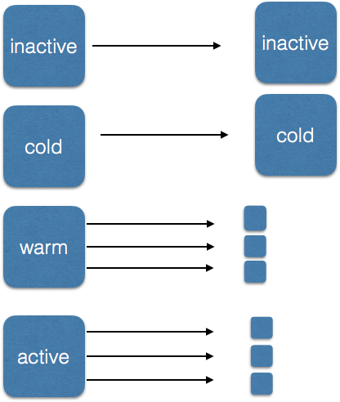
Customer Segmentation
Based on customer behavior they are segmented into 8 groups

Slide 4
Data / Metrics
What does our data look like ?
What are the metrics ?
$$$
Over 51,000 records

Slide 5
More on Data… (Key Performance Index )
Not too strong positive correlation between frequency and first purchase

Slide 6
Compare 2014 and 2015 customer segmentation

Slide 7

Model for data Analysis
Markov Chain Model
Transition Matrix
Combine 2014 and 2015 data
Use contingency between the two data.
Create probability value for the movements.

Slide 8
Net yearly revenue
PROJECTIONS
Segment population

Slide 9
Discounted Yearly Revenue
Cumulative Yearly Revenue

Slide 10
Conclusion
The net discounted cumulative total revenue in 2025 is projected to be little over 16 million and 434 thousands USD.
We project the enterprise discounted yearly revenue will decrease in 2025 by about 81 percent compared to the 2015 !
Risks
We made a crude estimate of the customer history.
Markov process ignores history.
We have not taken into account the new customers.

